Slide 1
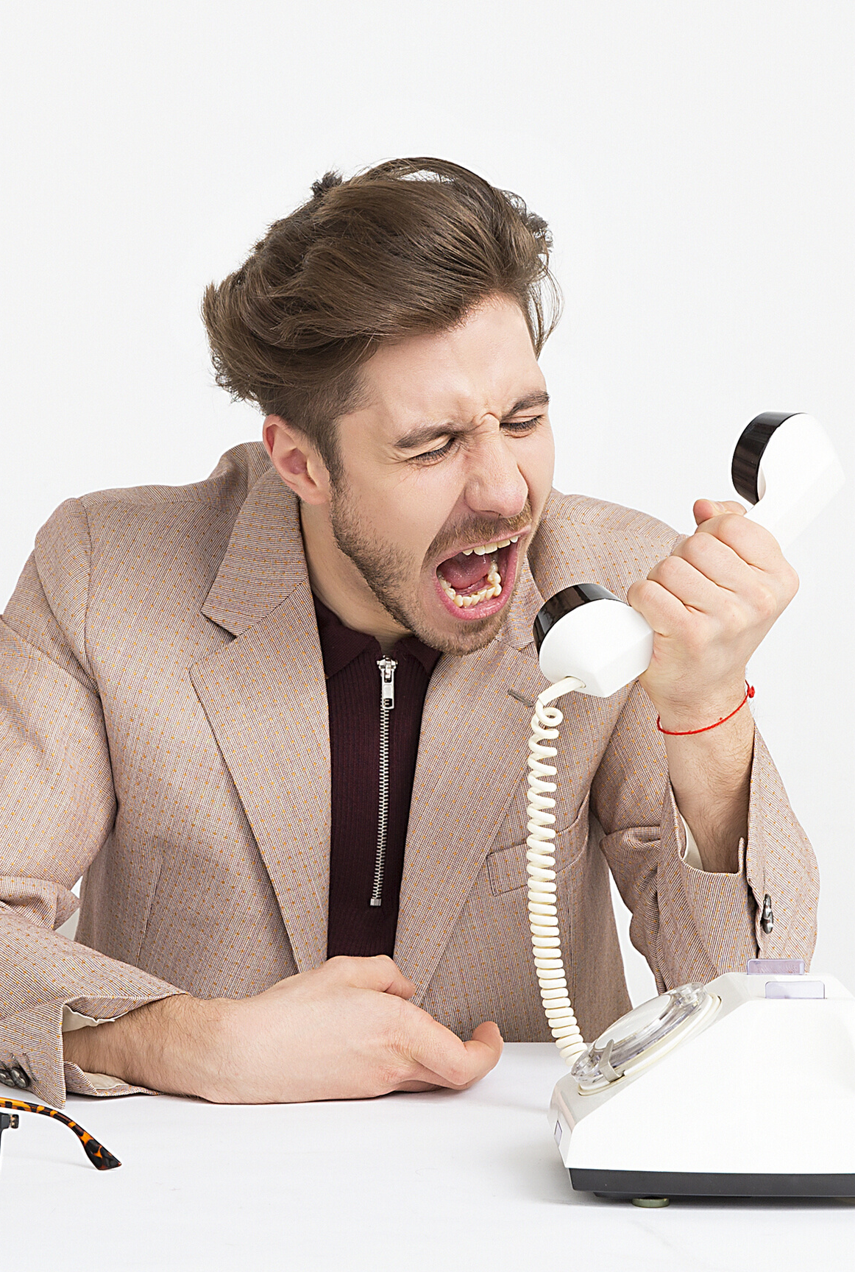

Business
Communication – Session A
Verbal Communication
COMPANY NAME | YEAR

Slide 2
Communication
Techniques
Speaking and Writing
General Tips
Objectives
Key Points
COMPANY NAME | YEAR

Slide 3







What is Communication?
An act of transferring information from one place, person or group to another.
Speaking
Listening
Watching
Touch
Smell
Taste
COMPANY NAME | YEAR

Slide 4

The Communication Process
The
person initiating the communication or broadcasting the message.
The
specific set of words, gestures and images that the sender uses to convey what he or she wants to say.
Receivers
(or the audience for the message) - from whom the receiver often expects a response.
The
channel through which the message moves.
SENDER
MESSAGE
CHANNEL
RECEIVER
The response from the Receiver to the Sender.
FEEDBACK
CONTEXT
COMPANY NAME | YEAR

Slide 5
The Communication Process
TO GET AND GIVE INFORMATION
TO ENSURE UNDERSTANDING
TO PERSUADE
TO GET ACTION
TO CHANGE BEHAVIOR
COMPANY NAME | YEAR

Slide 6
On the basis of Organisation Relationship
Formal
Informal
On the basis of Flow
Vertical
Crosswise/ Diagonal
Horizontal
On the basis of Expression
Oral
Written
Gesture
Types of Communication
Differential Points
COMPANY NAME | YEAR

Slide 7
Semantic Barriers
Symbols with different meaning, badly expressed message, faulty translation, un-clarified assumption, specialist’s language.
Emotional or Psychological Barriers
Premature evolution, inattention, loss of transmission & poor retention, undue reliance on the written word, distrust of communication, failure to communicate.
Barriers to Communication
Roadblocks
COMPANY NAME | YEAR

Slide 8
Organizational Barriers
Organizational policy, rules and regulations, status relation, complexity in organization.
Personal Barriers
Barriers in Superior - Attitude of Supervisor, fear of challenge of authority, lack of time, lack of awareness.
Barriers in subordinates - Unwillingness to communicate, lack of proper incentive.
Barriers to Communication
Roadblocks
COMPANY NAME | YEAR

Slide 9
Components
Verbal messages - the words we choose
Paraverbal messages – how we say the words
Nonverbal messages – our body language
These 3 components are used to:
Send clear, concise messages
Receive and correctly understand messages send to us.
Components of Communication
3 Main Aspects
COMPANY NAME | YEAR

Slide 10
Components
Verbal messages - the words we choose
Paraverbal messages – how we say the words
Nonverbal messages – our body language
These 3 components are used to:
Send clear, concise messages
Receive and correctly understand messages send to us.
Components of Communication
3 Main Aspects
COMPANY NAME | YEAR

Slide 11


Sending messages
Effective verbal messages Are brief, succinct and organized Are free of jargon Do not create resistance in listener.
COMPANY NAME | YEAR

Slide 12
Verbal vs Written Communication
Verbal - All Verbal
Advantages
Verbal - Face to Face
Advantages
Written
Advantages
Rapid Delivery
Flexible Delivery
Delivered at time/place under control of sender
Allows immediate response
More personal, so better motivation
Allows non-verbal signals to aid getting message across.
A record exists of the message
Allows receiver to repeat message until it is fully understood
Good for complex or lengthy messages
Allows receiver to digest message at own pace.
COMPANY NAME | YEAR

Slide 13
Make your message appropriate to the receiver.
Use understandable language but not slang.
Be aware of how long you speak. As a general rule, try to express your message in a limited amount of time (no more than 15 seconds in a normal day-to-day conversation) and then switch to listening.
Focus on one topic at a time.
Try to be positive, even when talking about negative situations.
Verbal Communication
Pointers
Key Points
COMPANY NAME | YEAR

Slide 14
A. B. C
Accuracy
Brevity
Clarity
K. I. S. S
Keep
It
Short
Simple
3 Stage Information Delivery
Introduction
Main Content of Body
Summary
Rules for Communication
Key Points
COMPANY NAME | YEAR

Slide 15
Ways to Encourage
Communication
Oral
Written
Effective ways to elicit information:
Asking effective questions
Intently Listening
Non-Verbal
COMPANY NAME | YEAR

Slide 16
Thank You!

